Slide 1
Student Engagement Analysis and Retention Prediction Portfolio
Prepared by: Ihor Melashchenko (C00290950), Software Development, Year 4

Slide 2
Analyzing Student Engagement to Improve Retention
Challenge:
  Universities need to identify at-risk students early
  Understanding app usage patterns can guide intervention strategies
Approach:
  Analyzed 400 students across 9 features (6 app metrics + 3 academic indicators)
  Two-part analysis:
    Unsupervised Learning: K-Means clustering to discover engagement patterns
    Supervised Learning: Predict dropout risk using ML models
Technologies:
  Python, Scikit-learn, XGBoost, Pandas, Seaborn

Slide 3
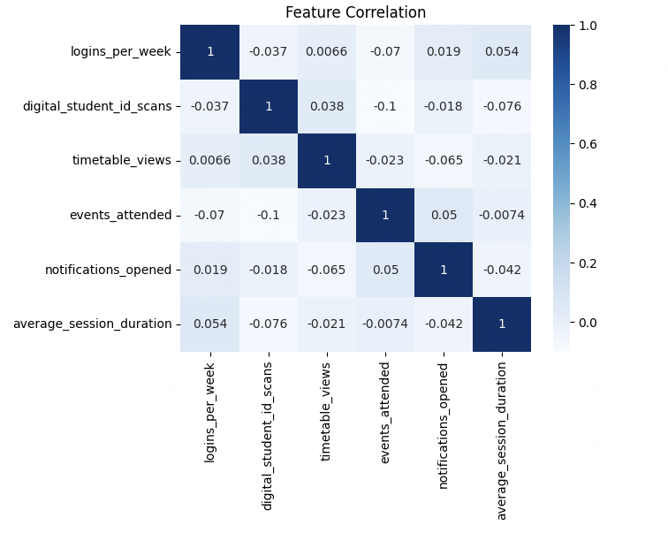

Slide 4
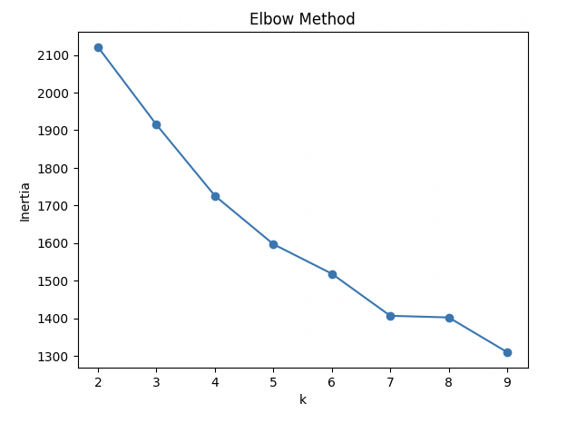

Slide 5
Three Distinct Student Segments Discovered
Methodology:
  K-Means clustering with k=3 (validated via Elbow Method)
  Features standardized using StandardScaler
  Silhouette Score: 0.52 (good cluster separation)
Three Student Personas:
  High Engagers (Cluster 0):
    Frequent app users across all features
    Strong academic performance
    Low dropout risk
  Moderate Engagers (Cluster 1):
    Average app usage
    Mixed academic outcomes
    Moderate dropout risk
  Low Engagers (Cluster 2):
    Minimal app interaction
    Weaker academic metrics
    High dropout risk

Slide 6
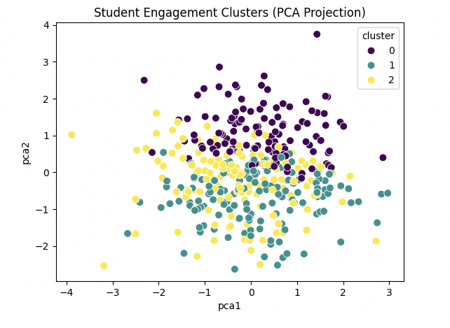

Slide 7
Predicting Student At-Risk Status
Following Criteria Must Be Met:
  Low logins (<6/week)
  Poor attendance (<75%)
  Low submissions (<60%)
  Low GPA (<2.2)
Models Tested:
  Logistic Regression (baseline)
  Random Forest (ensemble)
  XGBoost (gradient boosting)

Slide 8
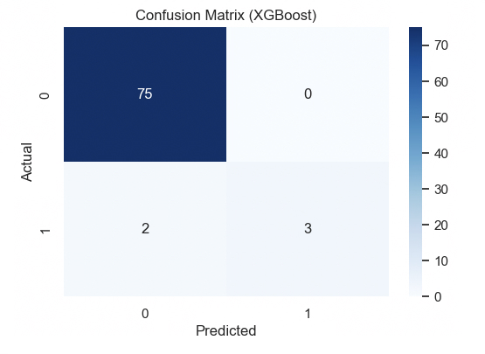

Slide 9
Thank you!
Any questions?

